Slide 1
Mobile Development :
2 : Mobile Apps : Idea, Planning, Design and Development
Professor Imed Bouchrika National School of Artificial Intelligence imed.bouchrika@ensia.edu.dz

Slide 2
Outline :
App Development Process
Idea & Market Research
Planning and Strategy
UX and Design
Development
Testing
Publishing and Maintenance
Usability & UX : Design Principles
Design Patterns for Mobile Apps
Business Models for Apps

Slide 3
In this course :
You will learn how to build an App ?

Slide 4
In this course :
Or, You will learn how to build a Business with an App ?

Slide 5
Warning :
Google and Apple will remove Apps from their stores which they don’t meet their requirements, making it difficult for poorly planned and executed apps to stay online

Slide 6
Reminder :
What’s the point of studying Software Engineering

Slide 7
Reminder :
What’s the point of studying Software Engineering
To produce a high quality software product via adopting a well-established process model to get tasks and activities well planned.

Slide 8
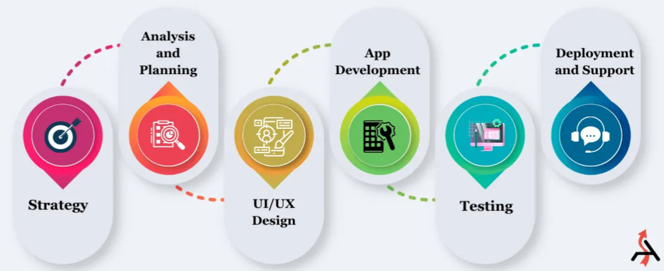

App Development Process
Copyright of the image belong to AgileInfoWays.com

Slide 9
App Development Process
Market Research and Strategy
This the most important stage where we :
Discover an idea
Conduct Market Research
Validate the idea
Draw the strategies to turn the idea into an app for a successful business.
01

Slide 10
App Development Process
Market Research and Strategy
How to find an idea in case you don’t have one ?
Identify a direct problem that your app can solve it.
Follow your passion : Consider creating an app about what interests you most ( hobbies, activities .. etc)
Penetrate to other markets/Go to the outside world in order to find a niche that you can master. The aim is to explore opportunities that you can exploit.
Monitor the market and see what developers are doing
01

Slide 11
App Development Process
Market Research and Strategy
How to find an idea in case you don’t have one ?
Identify a direct problem that your app can solve it.
Follow your passion : Consider creating an app about what interests you most ( hobbies, activities .. etc)
Penetrate to other markets/Go to the outside world in order to find a niche that you can master. The aim is to explore opportunities that you can exploit.
Monitor the market and see what developers are doing
Sitting behind a computer searching or asking chatGPT for ideas, may not be fruitful. It is highly recommended to go outside and explore the real problems next to you yourself.
01

Slide 12
App Development Process
Market Research and Strategy
How to find an idea in case you don’t have one ?
Searching the web ?
Analyse what people are searching for
Use keywords Volume Search
Marketplaces where Developers to sell Apps:
Flippa, ..
Websites where developers seek funding
Crunchbase
AngelList
..
01

Slide 13
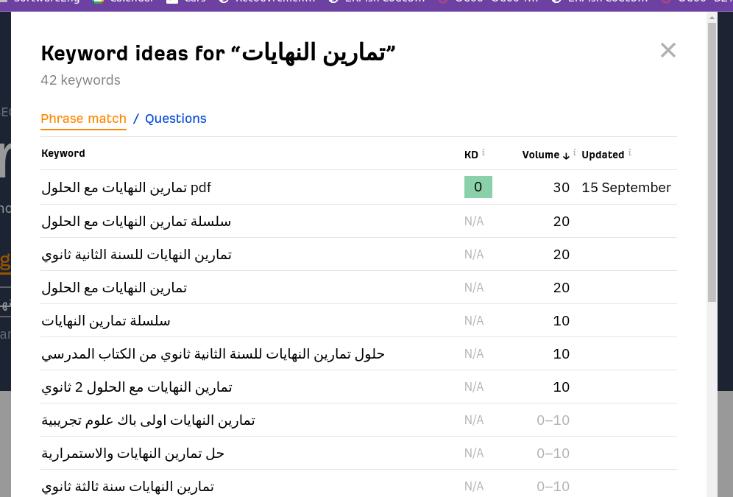
App Development Process
KD : Keyword Competition Difficulty
Volume : Number of Monthly Searches
Market Research and Strategy
How to find an idea in case you don’t have one ?
Searching the web ?
Analyse what people are searching for
Use keywords Volume Search
Marketplaces where Developers to sell Apps:
Flippa, ..
Websites where developers seek funding
Crunchbase
AngelList
..
01

Slide 14
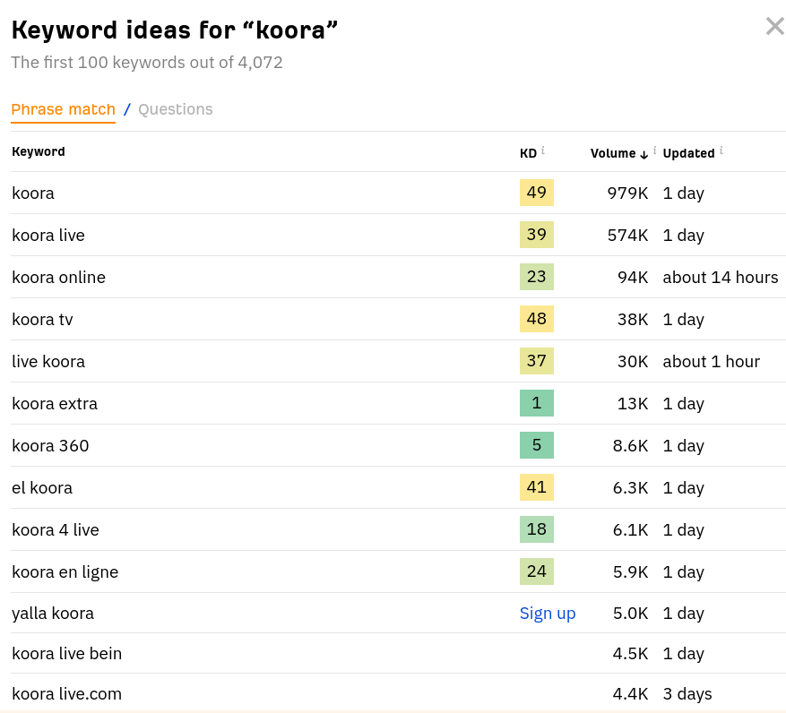
App Development Process
KD : Keyword Competition Difficulty
Volume : Number of Monthly Searches
Market Research and Strategy
How to find an idea in case you don’t have one ?
Searching the web ?
Analyse what people are searching for
Use keywords Volume Search
Marketplaces where Developers to sell Apps:
Flippa, ..
Websites where developers seek funding
Crunchbase
AngelList
..
01

Slide 15
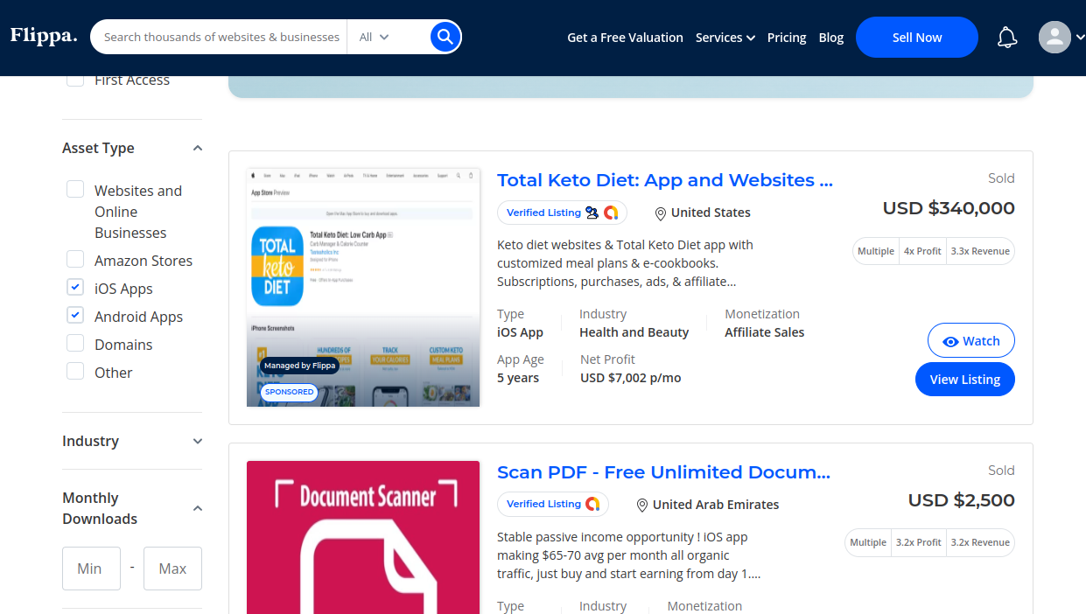

Slide 16
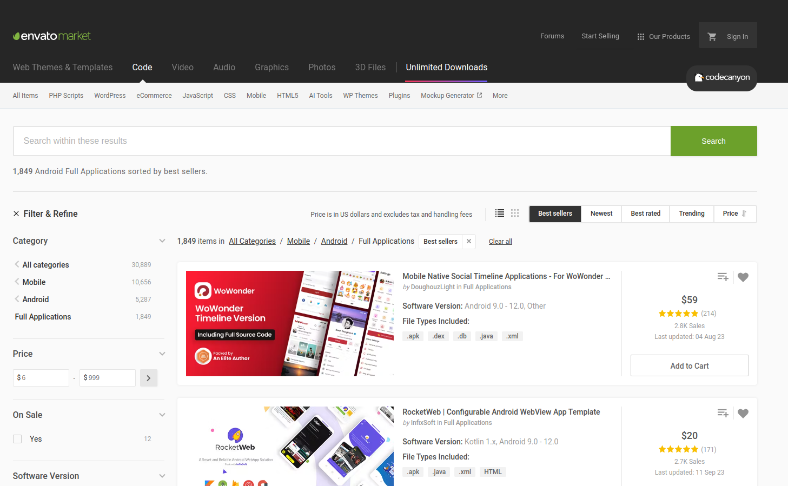
Note the business model here ?

Slide 17
App Development Process
Market Research and Strategy
If you have an idea for a mobile app :
Conduct intensive market research on whether the idea can be turned into a successful app.
Survey the competitions and see what gaps and opportunities you can exploit.
Collect as much statistical data about the competitions, similar apps as it helps you to gain deeper insights and have a clear vision.
01

Slide 18
App Development Process
Market Research and Strategy
Define the strategy to turn your idea into a successful app via :
Define the main objective of your app. “This App would do X and Y”. Use plain and Simple English, Be concise. Example : An App to help BAC students to understand the function limits
Identify your potential app users : Bac Students
Choose the mobile platform(s) : Android and iOS
01

Slide 19
App Development Process
Market Research and Strategy
Define the strategy to turn your idea into a successful app via :
Define a strategy to
Gain more users.
Keep the retention rate high
Keep your users active/engaged
Monetization process or business model for a sustainable app.
01

Slide 20
App Development Process
Market Research and Strategy
Does the idea need to be original ?
It’s rare now to claim that our ideas are original and none has thought about them. There are 26 million of software developers ( and entrepreneurs) thinking daily on how to create a good app.
Look at existing ideas and see how you can revamp them with different settings, business model, different types of audience ( Example, Yassir)
01

Slide 21
App Development Process
Market Research and Strategy
Idea Validation is the process to verify:
The assumption that your targeted audience truly needs your app to perform the intended task in order to solve an existing problem.
The idea can be developed as an App within the available resources ( Technology, Funding, HR, Legal....)
01

Slide 22
App Development Process
Market Research and Strategy
How to validate an idea for a mobile app ?
Defend why you try to solve the problem by writing a good and convincing problem statement answering the following questions:
What is the problem?
Who has the problem?
Why is the problem important?
How does your app solve the problem?
01

Slide 23
App Development Process
Market Research and Strategy
How to validate an idea for a mobile app ?
Market research on :
The size of your market ( # potential users)
Use keywords volume search
#downloads can give insight too.
The size of the competitions ( # apps , # downloads)
Assess the technical/financial feasibility
Seek feedback from : potential users + experts
01

Slide 24
App Development Process
Analysis & Planning
Requirement Engineering is performed to :
For the features to implement:
Capture the functional requirements
List potential wish-to-have features
Prioritize the functionalities based on their added-value vs. complexity vs. cost
List all non-functional requirements including scalability, storage, synching of data, speed,
02

Slide 25
App Development Process
Analysis & Planning
Requirement Engineering is performed to :
For the users to implement:
Identify the main target type of users ( Kids ? Employees at a given factory? Motorbike drivers ..)
Analyse and study their attributes and capabilities:
Educational level
Preferred language
Any accessibility issue
02

Slide 26
App Development Process
Analysis & Planning
Requirement Engineering is performed to :
For the hardware and Platform:
Analyze if there is are specific requirements for:
Hardware
Limited Screen Size ? Special Sensors ? Limited Memory ? Use of Stylus ? Has integrated Keyboard ? Battry Size vs Consumption ?
Platform :
Special operating system ? integration with legacy system
02

Slide 27
App Development Process
Analysis & Planning
Requirement Engineering is performed to :
For the context and environment:
Need to work in outdoor conditions.
Remote area with unstable internet connection
Users always on the move, need mostly voice-interaction instead…
Lighting is dark ? need better use of colors/contrast
02

Slide 28
App Development Process
Analysis & Planning
After collecting the raw requirements :
Requirements are analysed for :
Inconsistencies, conflict, missing requirements, feasibility, ambiguities, overlap…
The requirements are documented.
Requirements are verified and validated with the stakeholders.
Software Requirements Specification (SRS) document is produced
02

Slide 29
App Development Process
Analysis & Planning
A product roadmap/Timeline is prepared showing clearly the dates and milestones of the project. This includes:
02
Release of the prototype/Wireframe
Branding and Identity
Backend Architecture
Licensing and Administrative Procedures
Hiring & Human Resources
Publishing to App Stores
MVP Release
Dev Sprints (High Level)
Marketing events
etc..

Slide 30
App Development Process
Analysis & Planning
Planning for Marketing and Promotion events
Budget Planning for the project needs to be done.
How much financial resources are need to pay for :
Servers
Services and APIs
Designers
Copyrights
Staff…
02

Slide 31
App Development Process
UI & UX Design
For Mobile Apps, the success of the app is largely dependent on the perceived :
User experience : …
Usability aspect : ..
Artistic/Esthetic Look : ..
(Of course, in addition to the utility)
03

Slide 32
App Development Process
UI & UX Design
The goal of design is to design an easy to use app creating an excellent user experience to navigate easily between screens to perform the intended task.
The design phase is extremely important, critical and time-consuming ( Can be very expensive when outsourced )
As opposed to Enterprise Software Systems where performance, security, scalability…Mobile Apps are user-centric. They revolve around the user.
03

Slide 33
App Development Process
UI & UX Design
Designers will deliver:
Wireframes
Flow of Navigation between Screens
Prototypes
Mockups
Coloring Theme
Icons
Fonts
Images
…
03

Slide 34
App Development Process
Development:
Design the architecture of the software
Select the technology stack
Implementation and Integration
04

Slide 35
App Development Process
Development
Design the architecture of the software
Components ( Backend, Frontend, API endpoints, Services, External APIs.)
04
3rd Party Service
Cloud Storage
Database
Backend for Cloud Storage
Mobile App
endpoint
Admin Panel
Backend Server
endpoint

Slide 36
App Development Process
Development
Design the architecture of the software
Low-Level Design of each component : UML diagrams can be utilised to show :
Classes, Attributes and Relationships
Algorithms/Business logic for certain functionalities
04

Slide 37
App Development Process
Development
Design the architecture of the software
Communication Design : to describe the data flow and connection between various components.
Using RPC
Rest APIs
Queue-Based Communications.
04

Slide 38
App Development Process
Development
Design the architecture of the software
Database and Data Design :
Database Structures and Technologies
Local Database
Remote Database
3rd Party Database
Schema/format for data ( JSON, XML, CSV)
04

Slide 39
App Development Process
Development
Select the technology stack:
Platforms :
Operating System:
Android
iOS
Both
Hardware :
Phone, vs TV vs. Smart Watch vs …
04

Slide 40
App Development Process
Development
Select the technology stack:
Programming languages :
Kotlin : Becoming the preferred language for Android. Can be potentially used for iOS but not used.
Java : For android native apps + backend development + Web
Python : mainly for backend development + Web
Dart : The programming language for the flutter framework.
Swift : is the primary programming language for iOS app development.
Objective-C : Still popular for iOS, being slowly replaced by Swift.
JavaScript : mostly for web-based frameworks
04

Slide 41
App Development Process
Development
Select the technology stack:
Frameworks :
Flutter : Cross-platform framework developed for Google for building android and iOS apps
React Native : Developed by Facebook for developing iOS and Android native apps using JavaScript Technologies.
Xamarin : Cross-platform which uses C# and . iOS, Android and Windows. Owned by Microsoft.
Cordova (Ex-PhoneGap) : For building hybrid apps using web technologies.
Ionic : For building hybrid apps using web technologies
04

Slide 42
App Development Process
Development
Select the technology stack:
Database Engines :
SQLITE : supports both iOS and Android, Embedded, Serverless relational databases.
Realm : Supports both iOS and android.
Paid systems ( Couchbase mobile..)
Local file system
04

Slide 43
App Development Process
Development
Select the technology stack:
Backend Services
Java Spring Boot
Django
Flask
Java Spark
Laravel
04

Slide 44
App Development Process
Development
Select the technology stack:
External APIs and Services
Firebase
Backendless
Kinvey
Appery.io
04

Slide 45
App Development Process
Development
Implementation and Integration
Development of various components, services..
Integration and connecting components with:
Each other,
External APIs and libraries
04

Slide 46
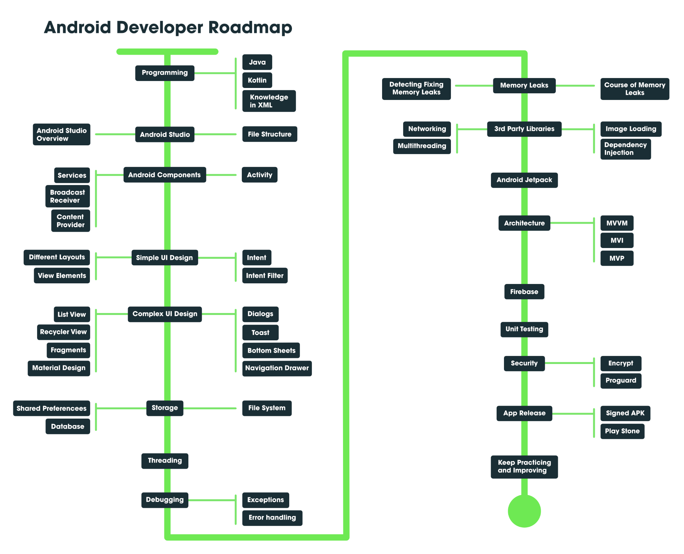
App Development Process
04
Copyright of https://www.geeksforgeeks.org/best-way-to-become-android-developer-a-complete-roadmap/

Slide 47
App Development Process
Testing & Quality Assurance
The testing phase is to ensure that the app once released:
It meets the highest quality standards
Users would not complain about missing features, non-working functionalities, bugs, distorted display….
Reduce maintenance and frequent updates…
05

Slide 48
App Development Process
Testing & Quality Assurance
The testing activity includes :
UX and Usability testing
Functionalities Testing + Unit Testing
Integration Testing
Performance Testing ( Includes also scalability, speed..)
Security Testing
Device and Platform Testing
Testing can be performed either in automated or manual way
05

Slide 49
App Development Process
Deployment & Maintenance
Either
Publish within the App Stores.
Deploy privately at the designated devices.
Monitor constantly feedback/reviews/ratings and take the necessary measures ( Address feedback, reply to questions, submit bugs to your internal issue-tracking system..)
06

Slide 50
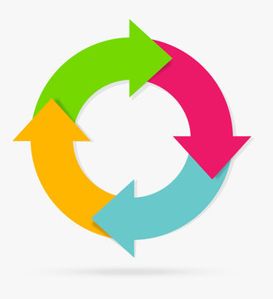
App Development Process
Analysis, Develop, Test and Publish :
It is an iterative process
With every incremental update you make to your application, it is crucial to test your app and see if it stands up to expectations or not
Testing an already released app, requires:
Testing all functionalities ( including the ones not-affected by)
Testing with existing data
Testing the migration if there is

Slide 51
Usability & UX : Design Principles
Usability
is defined as the extent to which a product can be easily used by specified users to achieve certain goals with effectiveness, efficiency and satisfaction.
Simply : how easy to use a software product to perform a task with few clicks, speed and better learnability rate…
Software systems are valued on the basis of its graphical interface and the related power of communication and expression for the implemented functionalities

Slide 52
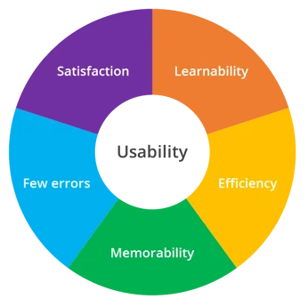
Usability & UX : Design Principles
Aspects of Usability
There are five aspects that constitute the usability :
Learnability : how easy to learn how to use the software
Efficiency : how fast to perform a given task
Memorability : Can I remember later on doing the previously done task ? and after a long time ? can I still remember ?
Errors : Few errors, for the user’s errors, I can undo them..
Satisfaction : I feel satisfied, i feel having control of the system..

Slide 53
Usability & UX : Design Principles
User Experience
Goes beyond the product interface, covering the entire experience with a product: how good the product was at helping them complete a job and did it work as expected and how they felt while using it
User experience (UX) can be simplified into four elements:
Usability – Was it easy to complete a task?
Adoptability – Do I want to repeat the experience?
Desirability – Was using the product fun and engaging?
Value – Is the product providing value – does it help me complete my task?

Slide 54
Usability & UX : Design Principles
Design Principles : Nielsen’s 10 Usability Heuristics (1994)
Visibility of system status
Match between system and the real world
User control and freedom
Consistency and standards
Help users recognize, diagnose and recover from errors
Error prevention
Recognition rather than recall
Flexibility and efficiency of use
Aesthetic and minimalist design
Help and documentation

Slide 55
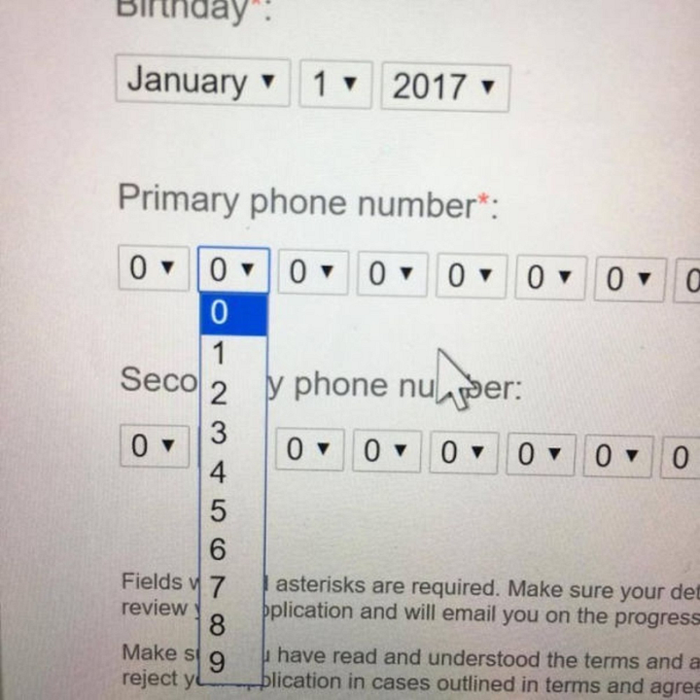
Usability & UX : Design Principles
Is this the efficient way to ask the user to provide their phone number ?
Is this the way we write phone number in in the real world ?

Slide 56
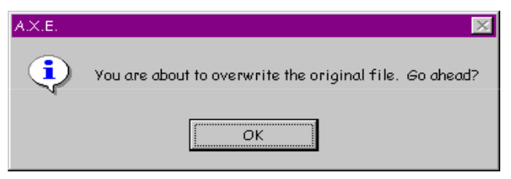
Usability & UX : Design Principles
Is the user feeling he is in control of their app ?

Slide 57
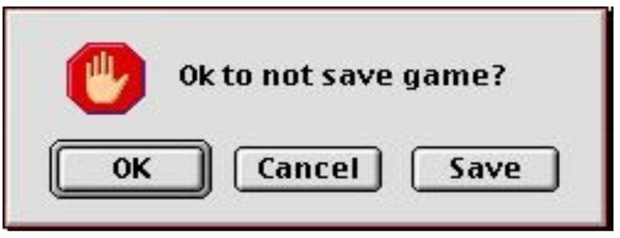
Usability & UX : Design Principles
In terms of norms and standards, we ask people with a negative sentence against the default action ?
Analogy :
Someone is invited to a table to eat and you tell “Ok, not to eat dinner ?”

Slide 58
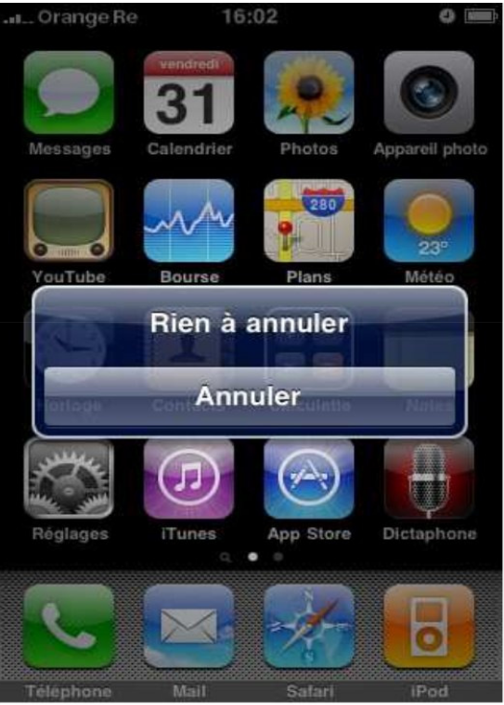
Usability & UX : Design Principles
Consistency of the message ?

Slide 59
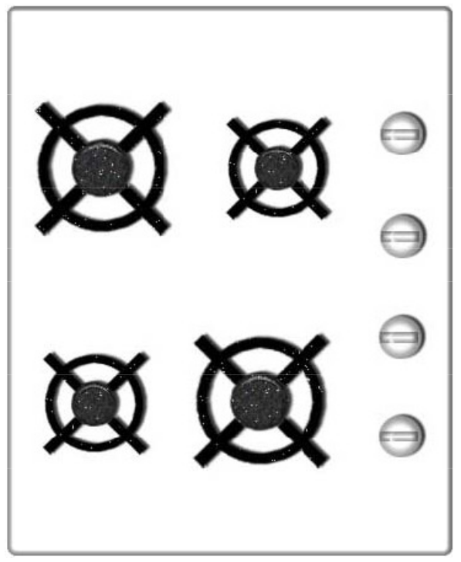
Usability & UX : Design Principles
How can I switch on the big hob at the top ?
I can learn now,
but , Memorability ? Can I recall after a long time ?

Slide 60
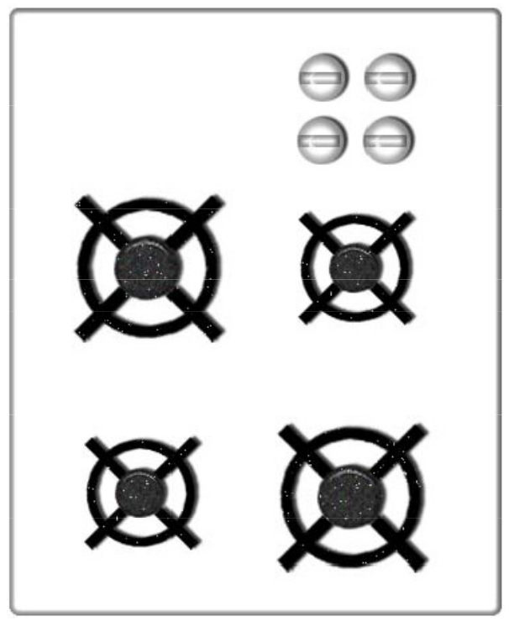
Usability & UX : Design Principles
Memorability ? Can I recall after a long time ?

Slide 61
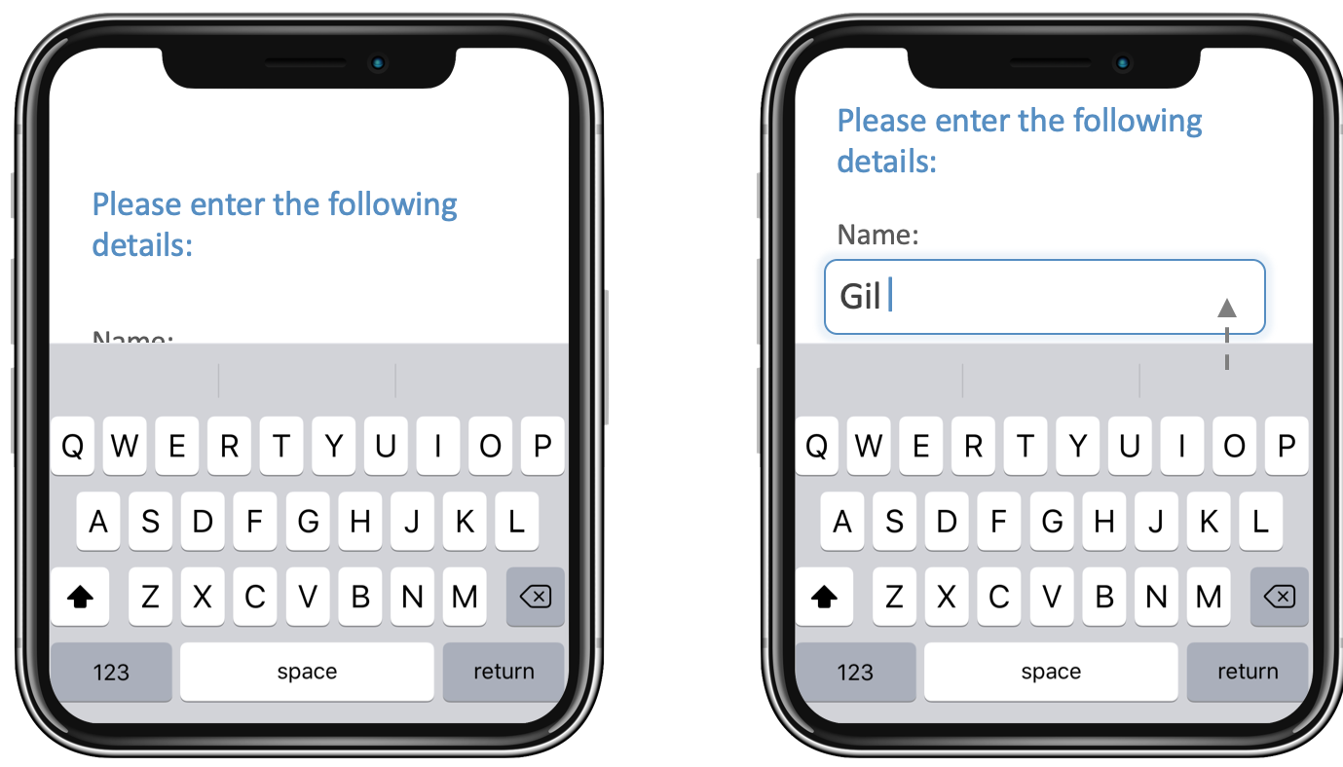
Usability & UX : Design Principles

Slide 62
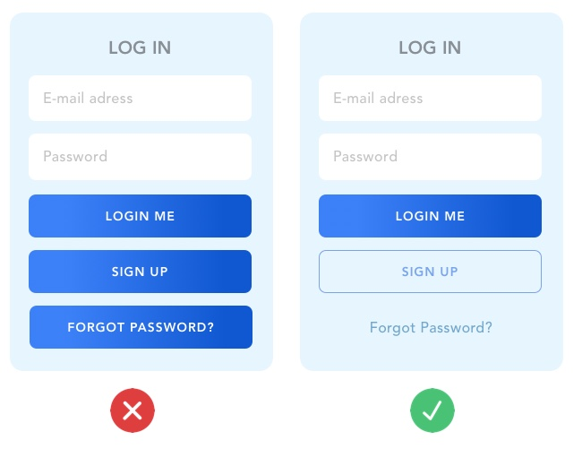
Usability & UX : Design Principles

Slide 63
Usability & UX : Design Principles

Slide 64
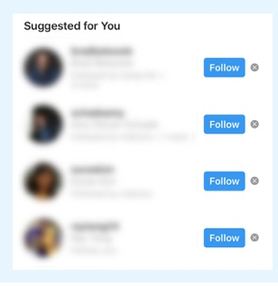
Usability & UX : Design Principles

Slide 65
Usability & UX : Design Principles
Recommended Design Principles for Mobile Apps:
Require minimal intervention : fewer steps to solve a problem, avoid unnecessary screens, form fields that can slow the users and even clutter the screen
Allow Flexible input
Provide smart defaults ( Default country ..)
Support direct manipulation, shortcuts of menu actions using hand gesture ( zooming an image..)

Slide 66
Usability & UX : Design Principles
Recommended Design Principles for Mobile Apps:
Inform users in relevant terms : Users want to know what is happening in meaningful and simple language
Make users feel in control:
Communicate in the user’s terms
Don't waste the user's time :
Performance
Reduce interruptions : Avoid Modal dialog, alerts…

Slide 67
Usability & UX : Design Principles
Recommended Design Principles for Mobile Apps:
Avoid mistakes : Users always and always make errors and mistakes. Your product should never make them feel stupid or harm them
Make it impossible to use it incorrectly
Offer the possibility to undo or correct the errors

Slide 68
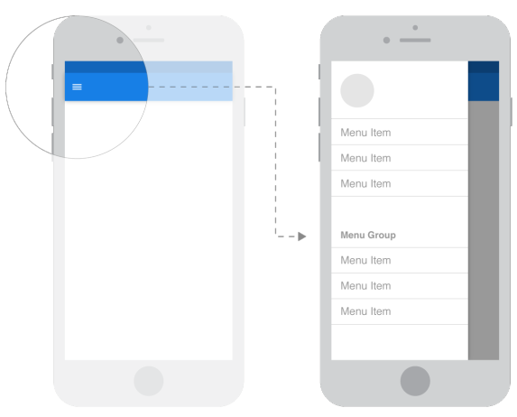
Design Patterns for Mobile Apps
Navigation :
Sliding drawer
Upper area tabs
Bottom menu
Back button
Floating buttons

Slide 69
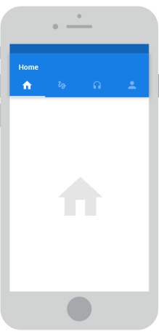
Design Patterns for Mobile Apps
Navigation :
Sliding drawer
Upper area tabs
Bottom menu
Back button
Floating buttons
Three dots menu

Slide 70
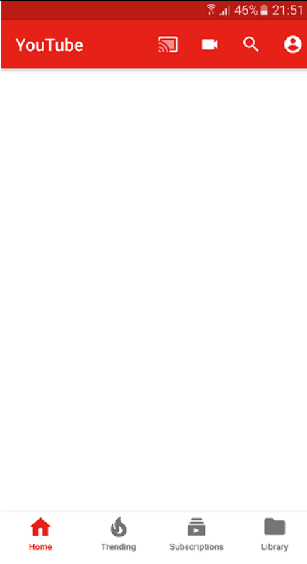
Design Patterns for Mobile Apps
Navigation :
Sliding drawer
Upper area tabs
Bottom menu
Back button
Floating buttons
Three dots menu

Slide 71
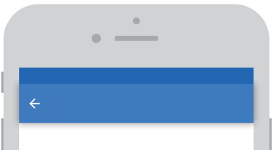
Design Patterns for Mobile Apps
Navigation :
Sliding drawer
Upper area tabs
Bottom menu
Back button
Floating buttons
Three dots menu

Slide 72

Design Patterns for Mobile Apps
Navigation :
Sliding drawer
Upper area tabs
Bottom menu
Back button
Floating buttons
Three dots menu

Slide 73
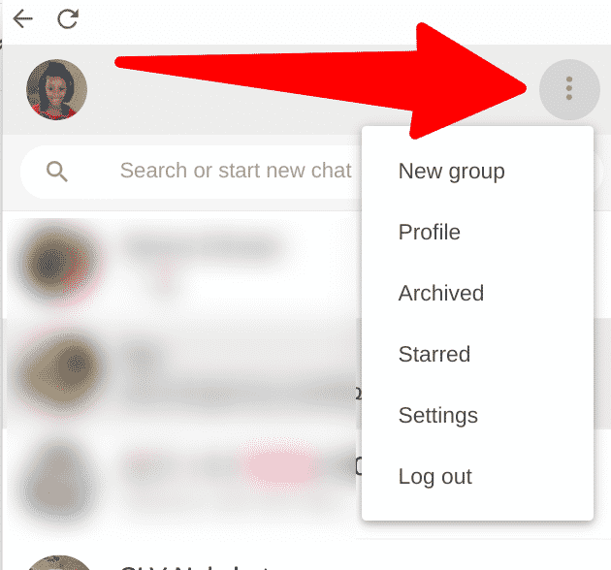
Design Patterns for Mobile Apps
Navigation :
Sliding drawer
Upper area tabs
Bottom menu
Back button
Floating buttons
Three dots menu

Slide 74
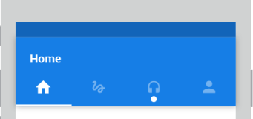
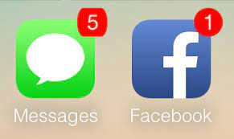
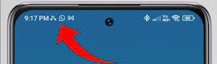
Design Patterns for Mobile Apps
Notifications :
Movement
Circle hint
Count notification app icon
Icons on Android Status bar

Slide 75
Design Patterns for Mobile Apps
Behavior Patterns :
Progressive Disclosure
Lazy Login
Swipe down to refresh

Slide 76
Design Patterns for Mobile Apps
Behavior Patterns :
Progressive Disclosure
Lazy Login
Swipe down to refresh

Slide 77
Design Patterns for Mobile Apps
Behavior Patterns :
Progressive Disclosure
Lazy Login
Swipe down to refresh

Slide 78
Business Models for Mobile Apps
What Business Model :
A business model is a “value capture framework” via which you monetize your product or service based on the value it creates for your customers.
Hence, it is value-based and NOT cost-based
There is no one universally right business model, as it depends on your specific situation

Slide 79
Business Models for Mobile Apps
Business Model : Up-Front Charge Model
A customer pays a large one-time up-front amount of money to obtain a product/service
Typically, the customer can also secure ongoing upgrades or maintenance of the product for a recurring fee
The model can serve in a large up-front infusion of cash to your business, but might impact your ability to secure a good enough recurring revenue stream.

Slide 80
Business Models for Mobile Apps
Business Model : Usage-Based Model
The usage-based model is similar to how electric and water utilities are metered (i.e., pay-as-you-go a service fee)
E.g., Cloud Computing services like Amazon EC2
The service fee is typically constant and NO up-front (or base or subscription) fee is incurred
The model provides control to customers over their expenses because they only pay for the amount of resources they use (rather than paying for extra capacity they do not use)

Slide 81
Business Models for Mobile Apps
Business Model : The Subscription or Leasing Model
A customer pays a subscription fee at the end of every predetermined time period (e.g., bi-weekly, monthly, annually, etc.) for obtaining your service or product E.g., Netflix
Typically, you can extract higher payments over shorter periods of time (e.g., monthly vs. yearly)
The model provides flexibility to customers (assuming they can unsubscribe at anytime) with predictable, fixed payments for businesses over agreed-upon periods of time

Slide 82
Business Models for Mobile Apps
Business Model : The Upsell Model
You can sell your product at a very low margin (or even free), but increase your overall margin via selling add-on products and/or charging for necessary future services
E.g., Consumer electronics (e.g., cameras) and automobiles (add-ons include warranty extensions, accessories, etc.)
Attractive for customers
Initially, they might not pay much
Profitable for businesses
They usually incur large margins on add-ons

Slide 83
Business Models for Mobile Apps
Business Model : Freemium Model
A customer pays zero money for a basic functionality of your product, but pays for obtaining premium features.
Many people can try your product
However, will these people (they are not customers until they pay) pay for the extra features available in your product?
Caveat: If people do not pay for your extra features, you do not have a business (recall the solo condition for having a business)

Slide 84
Business Models for Mobile Apps
Business Model : Advertising Model
You can make your product free, but monetize your ability to attract and retain a desirable demographic via providing Ads for third parties who want access to them (E.g., Google’s AdMob)
Appealing to users and third parties, especially that Ads are seamless (no banners!) and targeted
Caveat: many startups have fallen substantially short when they relied solely on Ads

Slide 85
Business Models for Mobile Apps
Business Model : Franchise or White-label Model..
If you own a good product with a good brand, you may let other business conduct business using your brand/app with a compliance to certain procedures…
The franchisee will pay a royalty fee or commissions from their sales/profit.

Slide 86
Business Models for Mobile Apps
Business Model : Franchise or White-label Model..
If you own a good product but not necessarily a good brand, you may let other business conduct business using your brand/app but their brand instead of your brand without the need to comply to regulations imposed with the franchise model.
Monetization can be achieved via a subscription fee, or commission based on their sales.

Slide 87
Business Models for Mobile Apps
Business Model : The “Parking Meter” Model
Parking meters charge low hourly parking rates (e.g., $0.25)
This seems to defy the logic of having large and expensive parking meters
However, the city charges high for parking tickets that become even higher if someone does not pay in an X (e.g., 10) number of days
No wonder cities have so many parking enforcement people!
Is not this aspect of the model akin to the one used by credit/debit card companies against defaulters?
Caveat: loyal customers might become alienated by late fees (discovered by Blockbuster and precluded by Netflix)

Slide 88
Business Models for Mobile Apps
There are more and more…
There will be a lecture at the end on the monetization process covering the business + technical aspects.

Slide 89
Resources
Pablo Perea, Pau Giner. “UX Design for Mobile”, 2017 ( Good Book on Mobile App Design )
https://www.youtube.com/watch?v=u7iUoxqKaKU&ab_channel=GoogleforDevelopers
https://www.ihci-conf.org/wp-content/uploads/2021/07/04_202105L012_Lupanda.pdf
https://www.agileinfoways.com/blogs/mobile-app-development-process/
https://www.saabsoft.com/blog/mobile-app-development-process/
https://improvement.stanford.edu/resources/usability-principles
https://userpilot.com/blog/usability-vs-user-experience/

